Slide 1



YOGA CLUB SOCIETY
EXCO MEETING
AGENDA
Friday, 11 September 2026
7:00 p.m., Google Meet
SUNGAI LONG CAMPUS
Notes:
Content source: Yoga Club EXCO Meeting Agenda – 11 September 2026.md, meeting header.
Visual language and embedded imagery reference: 1nd EXCO proposal meeting 2026.pptx.
Purpose: open the meeting, confirm attendance and establish the decision-making scope.
Facilitator guidance: confirm whether the meeting has the required EXCO representation. State that this meeting covers programme planning, recruitment, governance, finance, certification, staffing and merchandise. Ask members to distinguish confirmed decisions from proposals requiring later approval.
Record: attendance, apologies, meeting start time and any declared conflicts of interest.

Slide 2
UTAR SL YOGA CLUB
01
Decisions required at this meeting
PROGRAMME
Confirm compulsory activities and select the proposed trials for the next semester.
OCTOBER RD
Approve the promotion offer, Members’ Night link and Vice Treasurer recruitment message.
GOVERNANCE
Agree proposal, reporting, finance, attendance and publicity controls.
PEOPLE
Confirm certification rules, signatories and committee recruitment priorities.
RESOURCES
Shortlist merchandise and determine which activities require budget approval.
Meeting discipline
Record every decision with an owner and due date before the meeting closes.
EXCO MEETING, 11 SEPTEMBER 2026
2
Notes:
Content source: Yoga Club EXCO Meeting Agenda – 11 September 2026.md, overview of Items 1–12.
Visual language and embedded imagery reference: 1nd EXCO proposal meeting 2026.pptx.
Purpose: align members on the decisions that must leave the meeting with a named owner and completion date.
Discussion: confirm the activity portfolio first because proposals, publicity, budgets and recruitment depend on it. Resolve the October Recruitment Drive offer before publicity begins. Confirm which certification model requires further consultation. Treat merchandise and Members’ Night funding as conditional until the Treasurer completes the budget review.
Decision required: agree the sequence of decisions and identify any item that cannot be concluded without Ms Belinda, Ms Heng, a Core Advisor or DSA approval.
Record: decision, owner, due date, approval dependency and supporting document for every agenda item.

Slide 3

UTAR SL YOGA CLUB
02
Next semester activity plan
COMPULSORY PROGRAMME
Recruitment Drive
Weekly yoga classes
Free yoga classes
OPTIONS FOR REVIEW
Members’ Night as a reward for regular participants
One or two meditation sessions, free or paid
Natural Yoga pilot next semester or from February 2027
6–8
additional practical sessions during a long semester, scheduled around common free hours and certification needs
EXCO MEETING, 11 SEPTEMBER 2026
3
Notes:
Content source: Yoga Club EXCO Meeting Agenda – 11 September 2026.md, Item 1.
Visual language and embedded imagery reference: 1nd EXCO proposal meeting 2026.pptx.
Purpose: define the next-semester activity portfolio and distinguish compulsory work from optional pilots.
Compulsory activities: Recruitment Drive, weekly yoga classes and free yoga classes. For a long semester, consider six to eight practical sessions in addition to regular classes. These sessions may extend certification hours and create supervised training opportunities for student coaches. Use common student free hours when scheduling.
Options: assess Members’ Night as a reward for regular attendance. Decide whether meditation runs once, twice or weekly and whether participants pay a fee. Decide whether Natural Yoga begins next semester or moves to February 2027.
Decision required: approve the activity list, provisional frequency, semester timing and department responsible for developing each proposal.
Record: confirmed activities, deferred activities, responsible department and proposal due date.

Slide 4

UTAR SL YOGA CLUB
03
October Recruitment Drive
PROMOTION CONTENT
Club merchandise and lucky draw
Weekly-class certification
Members’ Night after the October free class, if confirmed
Possible benefits include food, health-oriented gifts and participant feedback
OFFERS AND RECRUITMENT
Review a free first class for first-time participants
Review fee waivers for members who bring new participants
Recruit the vacant Vice Treasurer during the drive
Collect participant and member feedback after the activity
EXCO MEETING, 11 SEPTEMBER 2026
4
Notes:
Content source: Yoga Club EXCO Meeting Agenda – 11 September 2026.md, Item 2.
Visual language and embedded imagery reference: 1nd EXCO proposal meeting 2026.pptx.
Purpose: agree the October Recruitment Drive offer and ensure publicity communicates only confirmed benefits.
Promotion: merchandise, lucky draw opportunities and weekly-class certification. If Members’ Night proceeds, promote it after the October free class. Possible benefits include food, health-oriented gifts, participant feedback activities and information about upcoming classes.
Participant offer: review whether first-time participants receive one free class. Consider a fee waiver for members who bring new participants to selected classes. The Treasurer should confirm any cost or revenue effect before Publicity publishes the offer.
Recruitment: include the vacant Vice Treasurer role in Recruitment Drive materials. Conduct a follow-up survey after the activity.
Decision required: approve the offer, benefit wording, survey owner and Vice Treasurer recruitment message.

Slide 5

UTAR SL YOGA CLUB
04
Secretarial deliverables and records
BEFORE EACH ACTIVITY
Prepare one proposal for every activity where required
Cover objectives, schedule, venue, budget, publicity, registration and approvals
Submit before the activity and within the required timeline
BY WEEK 14
Complete reports for weekly classes, the Recruitment Drive, both EXCO meetings and the free yoga class
Include Office Bearers and any other reportable activities or matters
CONTROL RECORD
Maintain a completed and outstanding checklist
Record student coach service hours and attendance
Review whether the club website can support traceability
EXCO MEETING, 11 SEPTEMBER 2026
5
Notes:
Content source: Yoga Club EXCO Meeting Agenda – 11 September 2026.md, Item 3; obvious source typo ‘Office Barriers’ normalised to ‘Office Bearers’.
Visual language and embedded imagery reference: 1nd EXCO proposal meeting 2026.pptx.
Purpose: establish a complete and traceable secretarial control system for proposals and semester reports.
Proposal standard: create one proposal for each activity where required. Each proposal should state objectives, programme details, schedule, venue, budget, publicity arrangements, registration process and required approvals. Submit the proposal before the event and within the institutional timeline.
Reporting standard: complete reports by Week 14 for weekly classes, the Recruitment Drive, EXCO Meeting 1, EXCO Meeting 2, the free yoga class, Office Bearers and any other reportable activity or matter.
Control mechanism: maintain a live checklist showing document status, owner, submission date and approval status. Record student coach service hours and attendance in a form that supports accountability and certificate issuance.
Decision required: approve the checklist format, report ownership and review frequency.

Slide 6

UTAR SL YOGA CLUB
05
Treasury policy and documentation
Establish a treasury policy and supporting documentation for every event
Maintain complete financial records for events and weekly classes
Pass confirmed financial arrangements to the Secretary and Publicity team
Publicity prepares pricing announcements after verification
The Secretary records the arrangements in proposals and reports
Fee tracking and unified receipt upload functions already exist on the proposed website and are not urgent
EXCO MEETING, 11 SEPTEMBER 2026
6
Notes:
Content source: Yoga Club EXCO Meeting Agenda – 11 September 2026.md, Item 4.
Visual language and embedded imagery reference: 1nd EXCO proposal meeting 2026.pptx.
Purpose: define how financial decisions move from the Treasurer into proposals, publicity and operational records.
Treasury responsibilities: prepare event-specific policy and documentation, confirm prices or member benefits, retain receipts and supporting evidence, and maintain records for weekly classes and events.
Information hand-off: once the Treasurer confirms the financial arrangement, the Secretary incorporates it into proposals and reports. Publicity then prepares the pricing announcement and payment instructions. Any subsequent change requires renewed verification before publication.
Digital support: fee tracking and unified receipt uploading already exist as proposed website functions. Treat them as useful but not urgent unless current record-keeping creates material gaps.
Decision required: confirm the minimum documents for each event and who verifies financial information before release.

Slide 7

UTAR SL YOGA CLUB
06
Student Instructor Programme
ELIGIBILITY
More than two semester-based Certificates of Completion
Or one yearly Certificate of Completion if the yearly system is adopted
Semester certificates apply only to long semesters of about 14 weeks
BENEFIT UNDER REVIEW
Fee waiver for student instructors who maintain more than 80% class attendance
PROPOSED SIGNATORIES
Instructor Ms Chew, Club Auditor, Club Chairperson, and Ms Belinda, Ms Heng or Core Advisor
EXCO MEETING, 11 SEPTEMBER 2026
7
Notes:
Content source: Yoga Club EXCO Meeting Agenda – 11 September 2026.md, Item 5.
Visual language and embedded imagery reference: 1nd EXCO proposal meeting 2026.pptx.
Purpose: agree entry conditions, benefits and signing authority for the Student Instructor Programme.
Eligibility: more than two semester-based Certificates of Completion, or one yearly Certificate of Completion if the club adopts the yearly model. Semester certificates apply only to long semesters of about fourteen weeks.
Proposed benefit: consider a fee waiver for student instructors who maintain attendance above 80 per cent. The Treasurer should assess the financial effect and the committee should clarify whether the waiver applies prospectively or retrospectively.
Signing authority: consider Ms Chew, the Club Auditor, the Club Chairperson, and Ms Belinda, Ms Heng or a Core Advisor. Confirm the required combination rather than assuming every person signs.
Decision required: select the eligibility model, attendance evidence, benefit rule and authorised signatories.

Slide 8

UTAR SL YOGA CLUB
07
Publicity guidelines and controls
PUBLICATION SCOPE
Recruitment Drive and free yoga classes
Weekly classes and certification
Members’ Night, lucky draw and merchandise
Meditation and other approved programmes
RELEASE CONTROL
Verify dates, venues, fees, payment instructions and participation requirements with the Secretary and Treasurer
Update materials when confirmed arrangements change
Archive posters, captions, announcements and registration links
EXCO MEETING, 11 SEPTEMBER 2026
8
Notes:
Content source: Yoga Club EXCO Meeting Agenda – 11 September 2026.md, Item 6.
Visual language and embedded imagery reference: 1nd EXCO proposal meeting 2026.pptx.
Purpose: create a controlled publicity process that prevents unconfirmed information from reaching members.
Scope: Recruitment Drive, free classes, weekly classes, Members’ Night, lucky draw activities, merchandise, meditation and other approved programmes.
Verification: Publicity should confirm event dates, venues, prices, member benefits, registration links, payment instructions and certification requirements with the Secretary and Treasurer before release. When arrangements change, update every affected poster, caption, announcement and link.
Records: retain the final published version and enough context to identify the event, publication date and approving source. Avoid keeping multiple files without a clear final status.
Decision required: approve the verification route, publication authority and archive location.

Slide 9
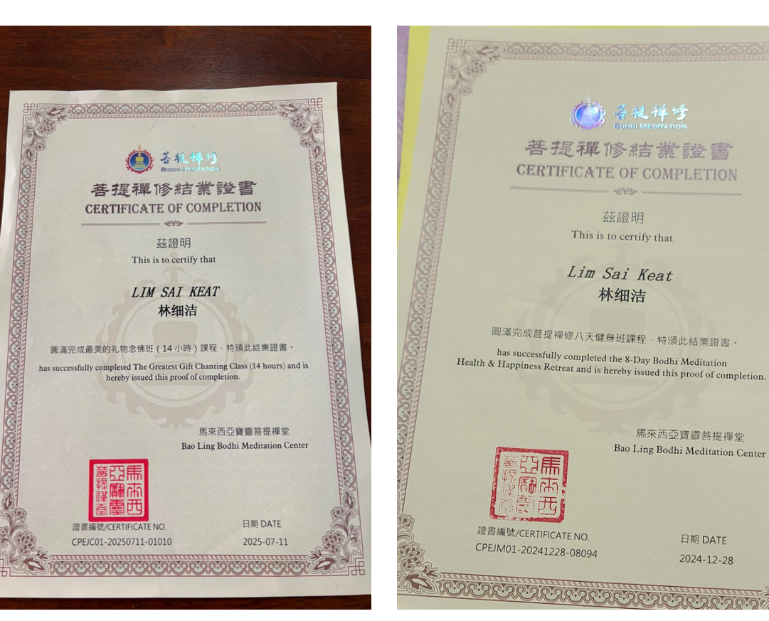
UTAR SL YOGA CLUB
08
Weekly class certification policy
80%
proposed attendance threshold for a semester-based Certificate of Completion (结业证书)
SEMESTER MODEL
Approximately 14 hours or 14 class days during a long semester
Short-semester attendance may accumulate towards the long-semester requirement
ALTERNATIVE YEARLY MODEL
STILL TO CONFIRM
Approximately 35 hours, 35 days or 35 yoga practice classes
Signatories: Ms Chew, Ms Xinle, Club Chairperson, and Ms Belinda, Ms Heng or Core Advisor. Confirm permitted Yoga Club, DSA and UTAR logos.
EXCO MEETING, 11 SEPTEMBER 2026
9
Notes:
Content source: Yoga Club EXCO Meeting Agenda – 11 September 2026.md, Item 7.
Visual language and embedded imagery reference: 1nd EXCO proposal meeting 2026.pptx.
Purpose: finalise a certification policy that the club can explain consistently and verify through attendance records.
Semester model: at least 80 per cent attendance across approximately fourteen hours or fourteen class days during a long semester. Attendance from a short semester may accumulate towards the long-semester requirement.
Yearly alternative: approximately thirty-five hours, thirty-five days or thirty-five yoga practice classes. The committee must choose one measurable unit and explain how mixed class durations count.
Signatories and logos: consider Ms Chew, Student Coach HOD Ms Xinle, the Club Chairperson, and Ms Belinda, Ms Heng or a Core Advisor. Confirm whether Yoga Club, DSA and UTAR logos are permitted and whether separate approval applies to each.
Decision required: select the certification model, measurement unit, evidence source, signatories and permitted logos.

Slide 10
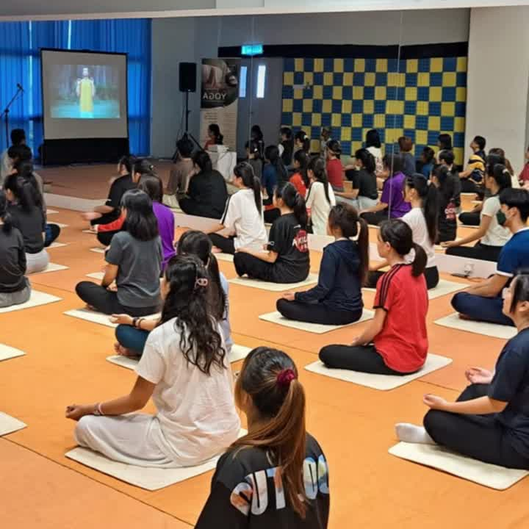
UTAR SL YOGA CLUB
09
Higher committee recruitment
PRIORITY VACANCIES
VICE CHAIRPERSON
Identify a suitable current committee member with a strong student network.
PUBLICITY TEAM
Recruit one additional member to support the coming programme.
RECRUITMENT ROUTE
Committee referrals and suitable EA appointments for experience-based instructor, committee and event-support roles
EXCO MEETING, 11 SEPTEMBER 2026
10
Notes:
Content source: Yoga Club EXCO Meeting Agenda – 11 September 2026.md, Item 8.
Visual language and embedded imagery reference: 1nd EXCO proposal meeting 2026.pptx.
Purpose: fill leadership and publicity capacity gaps before the next semester begins.
Priority roles: recruit one additional Publicity team member and identify a suitable current committee member with a strong network for Vice Chairperson. The committee should also consider additional higher committee members where workload or succession risk justifies recruitment.
Recruitment routes: committee referrals, direct invitations and EA appointments for experience-based roles connected with student instruction, committee participation, events or publicity support.
Assessment: consider availability, reliability, role understanding, relevant experience and willingness to complete documentation. Personal networks may identify candidates, but the role requirements should govern selection.
Decision required: confirm vacancies, selection criteria, recruiter and target completion date.

Slide 11

UTAR SL YOGA CLUB
10
New Yoga Club merchandise
HIGHER-END
Logo cape or cloak, yoga mat, yoga bricks
MIDDLE-RANGE
Yoga brick, T-shirt, hat, stretching strap
LOWER-COST
Keychain, lanyard, rubber wristband, other suitable small items
Decision
Every committee member selects at least three preferred items. Publicity designs the shortlist, the Secretary updates the proposal and the Treasurer confirms supplier pricing and pre-funding.
EXCO MEETING, 11 SEPTEMBER 2026
11
Notes:
Content source: Yoga Club EXCO Meeting Agenda – 11 September 2026.md, Item 9.
Visual language and embedded imagery reference: 1nd EXCO proposal meeting 2026.pptx.
Purpose: reduce the merchandise list to a feasible shortlist before design and supplier work begins.
Choices: higher-end items include a logo cape or cloak, yoga mat and yoga bricks. Middle-range items include a yoga brick, T-shirt, hat and stretching strap. Lower-cost options include a keychain, lanyard, rubber wristband and other suitable small items.
Polling: every committee member should participate and select at least three preferred items from the limited choices. Record the number of votes rather than only the winning items.
Dependencies: Publicity prepares designs, the Secretary includes selected merchandise in the proposal, and the Treasurer confirms supplier pricing, minimum order quantities and pre-funding requirements before commitment.
Decision required: agree the polling deadline, shortlist size and budget ceiling for supplier enquiries.

Slide 12
UTAR SL YOGA CLUB
11
Members’ Night and lucky draw
PURPOSE
Recognise regular June-class participants and welcome new club members.
BUDGET CONDITION
Club funding for the lucky draw requires budget review and approval before commitment.
POSSIBLE MEMBER BENEFITS
Free food or health-oriented gifts
Selected club merchandise in the lucky draw pool
Feedback survey and promotion of upcoming yoga classes
EXCO MEETING, 11 SEPTEMBER 2026
12
Notes:
Content source: Yoga Club EXCO Meeting Agenda – 11 September 2026.md, Items 2.3 and 10.
Visual language and embedded imagery reference: 1nd EXCO proposal meeting 2026.pptx.
Purpose: determine whether Members’ Night and a lucky draw provide a proportionate and affordable reward for member participation.
Audience: regular participants from the June weekly classes and new members joining the club. Clarify whether attendance history, current membership or event registration determines eligibility.
Possible benefits: food, health-oriented gifts, selected merchandise, participant feedback and promotion of future classes. Publicity should avoid promising benefits before budget confirmation.
Financial condition: any use of club funds for the lucky draw requires budget review and approval. The Treasurer should document expected cost, item source and purchasing evidence.
Decision required: confirm whether the activity proceeds, eligibility, benefits, provisional budget and approval route.

Slide 13
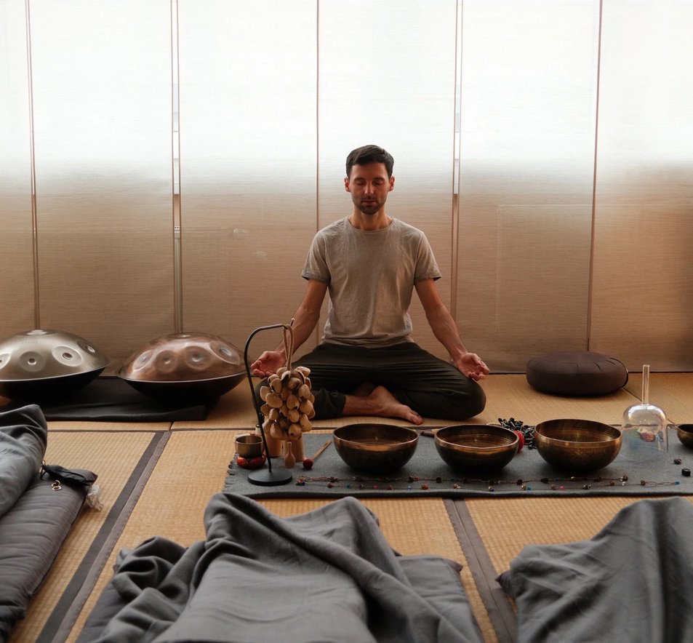
UTAR SL YOGA CLUB
12
Meditation and practice-class pilot
PILOT FORMAT
Meditation, additional yoga practice, or both
One selected day or a weekly format
Potentially delivered fully by student instructors
Location and participation fee remain to be confirmed
SERVICE CERTIFICATION
Yearly certificates may record the number of events, total service hours and the individual’s role in instruction, organisation or publicity.
EXCO MEETING, 11 SEPTEMBER 2026
13
Notes:
Content source: Yoga Club EXCO Meeting Agenda – 11 September 2026.md, Item 12.
Visual language and embedded imagery reference: 1nd EXCO proposal meeting 2026.pptx.
Purpose: test whether student instructors can deliver meditation or additional yoga practice safely and consistently.
Pilot design: choose meditation, yoga practice or both. Decide whether the pilot runs on one selected day or weekly. Confirm venue, participant fee, instructor eligibility, supervision and attendance recording before publicity begins.
Certification: eligible student instructors may receive certification under the approved framework. Event organisation and publicity personnel may receive separate yearly service certificates that state events supported, total service hours and role.
Accountability: record responsibilities by hours and retain enough evidence to verify service claims.
Decision required: approve the pilot scope, frequency, location owner, supervision arrangement and service-record method.

Slide 14
UTAR SL YOGA CLUB
13
Open matters and governance checks
YOGA DAY
Consult Ms Belinda on information and approval requirements for a larger-scale event.
ATTENDANCE
Agree an improved recording method for weekly classes and other activities.
WEBSITE
Determine which record, fee and receipt functions should move into the proposed club website.
COVERAGE
Identify any additional activity, meeting or matter requiring a proposal or semester report.
FEEDBACK
Invite final suggestions and unresolved departmental concerns.
EXCO MEETING, 11 SEPTEMBER 2026
14
Notes:
Content source: Yoga Club EXCO Meeting Agenda – 11 September 2026.md, Items 3.9–3.12 and 11.
Visual language and embedded imagery reference: 1nd EXCO proposal meeting 2026.pptx.
Purpose: resolve cross-cutting matters that affect several departments or require external clarification.
Yoga Day: consult Ms Belinda about institutional requirements, information needs and approvals for a larger-scale event. Do not begin public promotion until the approval route is understood.
Attendance: select a recording method that captures participant identity, date, activity and verified attendance. The method should support certification and coach service-hour records.
Website: decide whether the proposed club website should hold attendance, fee status and receipt uploads. Define access rights and the authoritative record before moving information online.
Decision required: identify unresolved matters, owner, consultation target and return date for each issue.

Slide 15
BEFORE WE CLOSE
Confirm the decision,
owner and due date
Secretary updates the proposal and report checklist
Departments verify their assigned actions
Any approval dependency is recorded explicitly
Meeting minutes capture the final decisions
UTAR SL YOGA CLUB, SUNGAI LONG CAMPUS
Notes:
Content source: Yoga Club EXCO Meeting Agenda – 11 September 2026.md, meeting close and action-recording requirement derived from Items 3, 4, 6 and 11.
Visual language and embedded imagery reference: 1nd EXCO proposal meeting 2026.pptx.
Purpose: convert meeting discussion into an accountable record.
Close-out check: read back each decision and confirm that members interpret it in the same way. Name one accountable owner, even when several departments contribute. Add a due date and identify the document or evidence that demonstrates completion.
Dependencies: record any DSA, advisor, instructor, Treasurer or Secretary approval needed before work proceeds. Mark unresolved items clearly and set a date for returning them to the committee.
After the meeting: the Secretary updates the minutes and proposal-report checklist. Department leads verify their actions and notify the Secretary when circumstances change.
Record: final decisions, dissent or reservations where relevant, owners, due dates, approval dependencies and the next review point.

